Slide 1

OptiVision: Advanced Screening for Early Detection of Vision Impairments
By the students:
Tameer Amer 322836388.
Redan Ganim 209003474.
By the mentor:
Dr.Natali Levi.
Notes:
Hello everyone, my name is redan ganim and my teammate is Tameer Amer we ,under the guidance of Dr. Natali Levi.
Our application called Opti Vision

Slide 2
Introduction
OptiVision is a desktop application designed for early detection of vision problem.
Millions of people worldwide don’t know they have vision problems.
The project provides an easy-to-use solution for home-based vision screening.
Our app makes it easy for anyone to test their vision from home.
Notes:
OptiVision is a desktop application designed for early detection of vision problems,
Millions of people around the world suffer from vision problems without knowing it.
OptiVision is designed to help solve this issue by offering an easy-to-use tool for early detection of vision problem.
The application allows users to perform simple tests at home, so they can catch potential issues before they worsen.

Slide 3
Problem Statement
Many people don’t realize they have vision problems until it’s too late..
There aren’t enough easy-to-use tools for people to test their eyes at home.
Late diagnosis can cause serious health issues and lower the quality of life.
OptiVision help solves this with a simple home vision test.
Notes:
Many people don’t realize they have vision problems until it’s too late. there are 2.2 b with vision problems and 1b of them vision impairment could have been prevented
Currently, there aren’t many easy and accessible tools for testing your eyes at home.
This delay in diagnosis can lead to more serious health issues and significantly impact quality of life.
OptiVision aims to solve this problem by providing simple home-based tests that people can use at their comfort zone.

Slide 4
Existing Solutions
Eye Examination:
School-Based Vision Screenings:
-Basic tests by teachers or school nurses.
-Basic eye tests to identify students who may have vision problems.
Digital Tools and Apps:
-Early at-home vision test apps. -Not very accurate or well-calibrated.
-Done by eye doctors. -Time-consuming and expensive.
Notes:
There are a few existing solutions, but each has its limitations:
Eye Exams: Conducted by doctors, but these are time-consuming and expensive approximately 200-500 skekls each apointment.
School Vision Screenings: Basic tests done by teachers or nurses. However, they are not very perfect and may miss serious problems.
Digital Tools: There are apps available, but they often lack accuracy and are not calibrated properly.

Slide 5
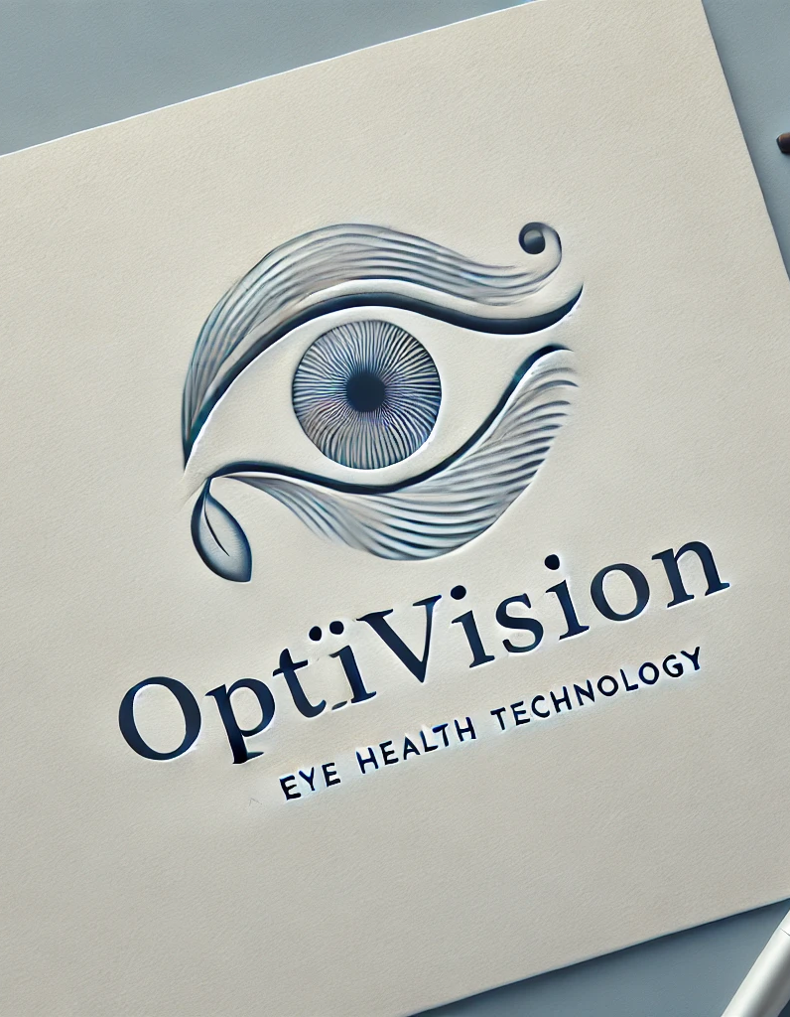
Our Solution
Comprehensive Testing: Several tests for more accurate results.
Accessibility: Users can perform tests anytime at home.
Early Detection: Help people catch problems early.
Affordable: Reduces clinic visits.
Track Your Data: Saves your results and gives advices.
Notes:
Comprehensive Testing: to include several tests to ensure more accurate results.
Accessible: user can perform tests from anywhere, at any time.
Affordable: It helps reduce the need for frequent clinic visits.
Data Tracking: The app securely saves your results so you can track your vision health over time.

Slide 6

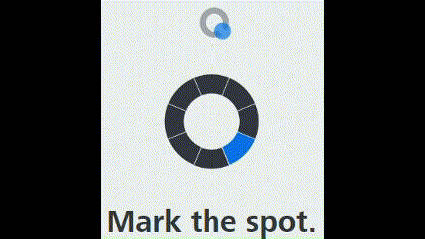
Our Vision Tests
Visual Acuity Test
Contrast Test
Notes:
The Visual Acuity Test checks how clearly you can see, while the Contrast Test helps assess how well you can differentiate between light and dark objects.
Visual Acuity: How sharp your vision is.
Contrast Sensitivity: How well you see differences in brightness.

Slide 7
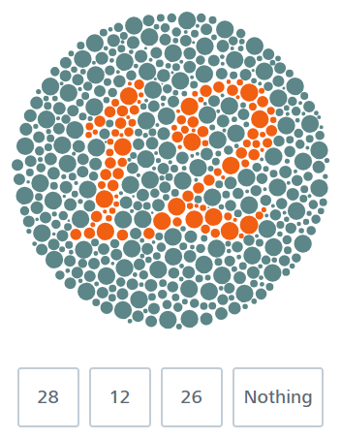
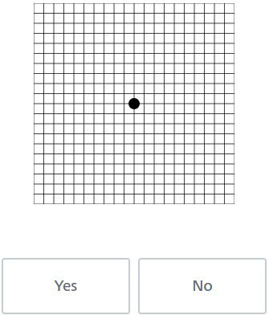
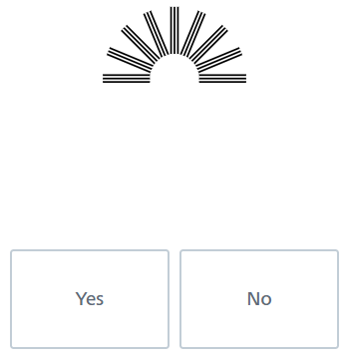
Focus on the black dot in the center. Do all lines and squares appear equal and regular?
Do all the lines look like they
Are the same shade of black?
Select the number you see in the circle:
Color Blindness Test
Field of Vision Test
Blur Detection Test
Notes:
We also include a Color Blindness Test to determine if users can differentiate colors, and a Field of Vision Test to check how wide a user’s field of view is without turning their head.
Color Vision: Your ability to see and differentiate colors.
Blur Detection: Tests if your vision is blurry.
Field of Vision: How much you can see without moving your eyes.

Slide 8
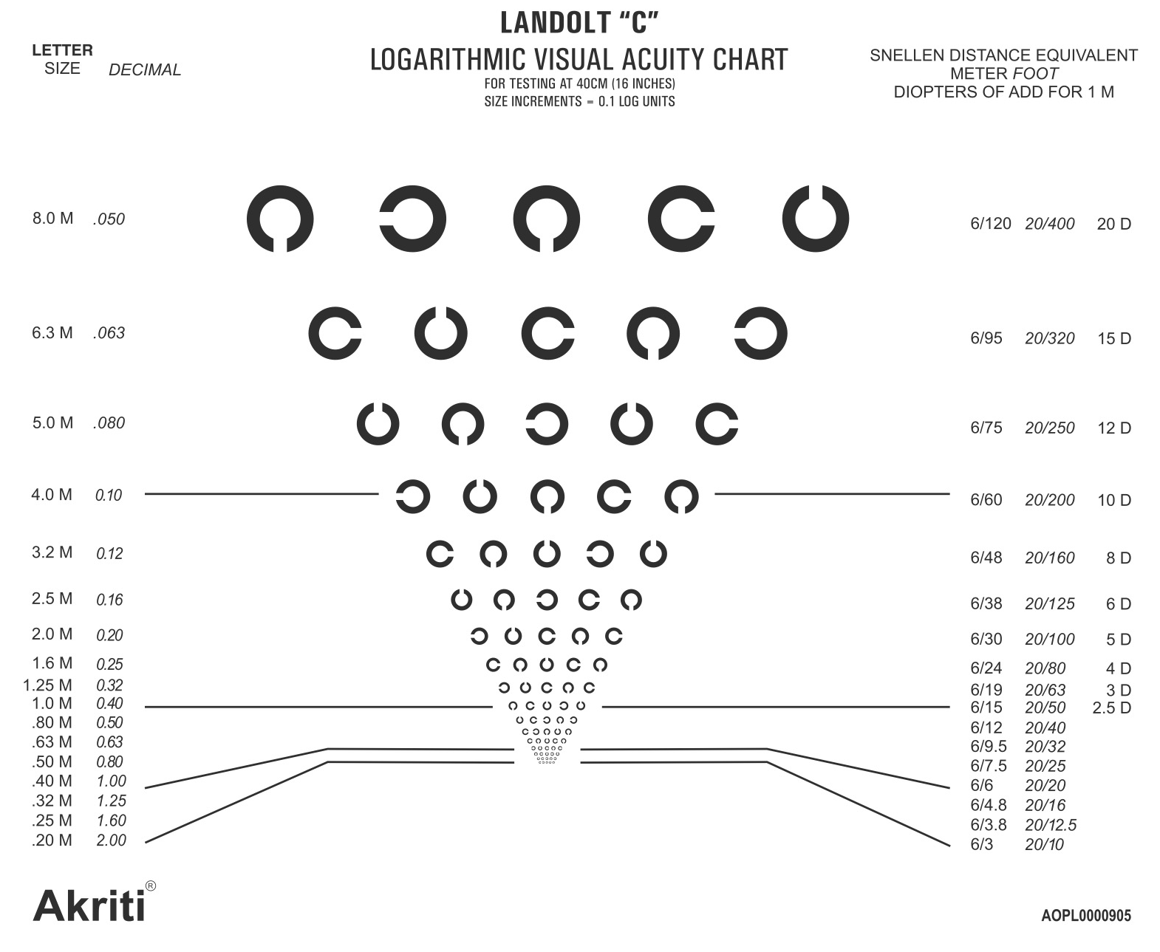
Algorithm
Rank Levels (1-17): Levels are ranked from easiest (1) to hardest (17).
Start at Level 1.
Progression Rules:
Correct answer at Level 1 moves you to Level 3, continuing with +2 levels for each correct answer until Level 10.
After Level 10, advance one level at a time.
Incorrect Answer Handling:
First incorrect answer: Drop down by 1 level.
Second incorrect answer: Drop another level.
Allowed 3 incorrect answers in total.
Determine Final Vision Level: The highest level passed accurately is recorded as the final visual acuity.
Notes:
THIS is out algorithm for testing first of all we divine all ladolt C chart to 17 part
The user start form level 1
When the user answer correctly he move ahed 2 levels if answer wrong return 1 level to get best result and accrutly
return the highest level that user pass after 3 mistakes
If user don’t get pass the first 3 level he start again al level 4 because if he don’t see the fist 4 level that doesn’t mean thet he blind

Slide 9
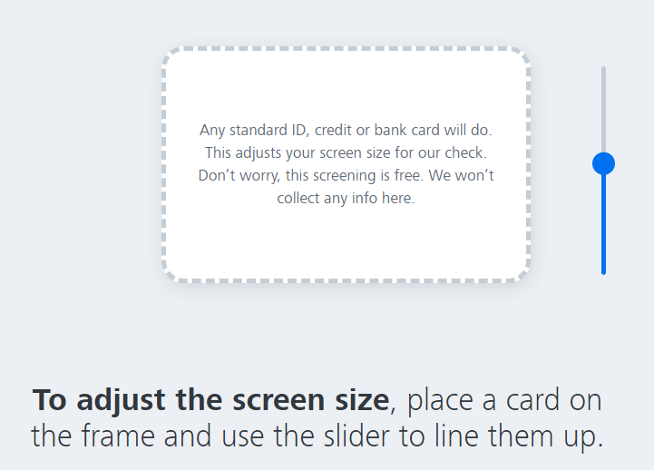
Screen Calibration
Why Calibration Matters: Ensures that all tests are scaled correctly for the user's specific monitor size.
Users calibrate their screen using a real-world object (e.g., credit card or ID) to adjust screen dimensions.
Calibration ensures accurate results across different monitors and screen settings.
Notes:
"Screen calibration is important for accurate test results.
By using a real-world object, like a credit card or ID, users can adjust the screen size to match true dimensions.
This ensures that the test scales correctly to the monitor, providing reliable and consistent results across different devices.
Proper calibration helps us maintain accuracy in a anywhere environment, making the tests as precise as possible."

Slide 10
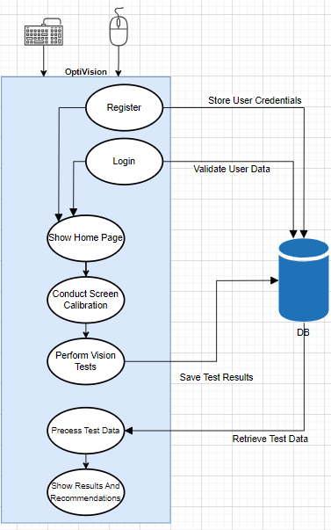
System Architecture
In the DB, we store:
The user information (username, password, email…).
The user tests results.
Notes:
We have an interaction with the database in the register and login process in order to validate the user data.
We also interact with the database in the result saving process, and the data retrieval in order to analyze them.

Slide 11
Functional Flow
User Login/Registration: User signs in or creates an account to access the app.
Screen Calibration: User performs initial screen calibration for accurate test measurements.
Perform Vision Tests: User selects and completes a vision test.
Process Results: System analyzes the test data.
Results Display: User views the test results and system recommendations.
Save Results: Test results are stored in the database for future reference.
Review Past Results: Users can access their test history to track their vision health over time.
Notes:
Next After that Then

Slide 12



Technology Stack
Programming Language:
Desktop App:
Database:

Slide 13
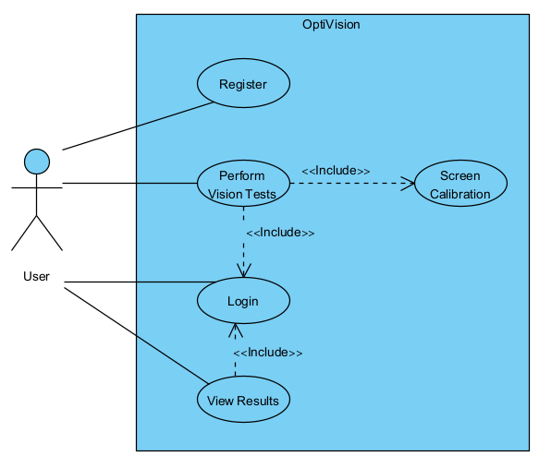
Use Case Diagram

Slide 14
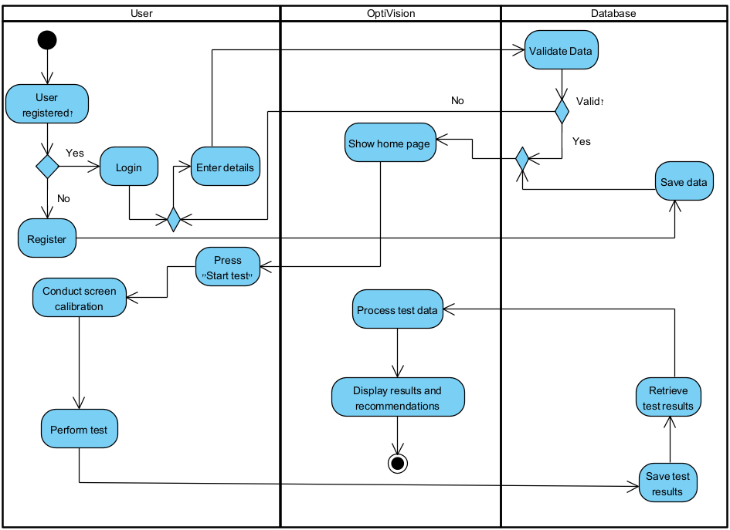
Activity Diagram

Slide 15
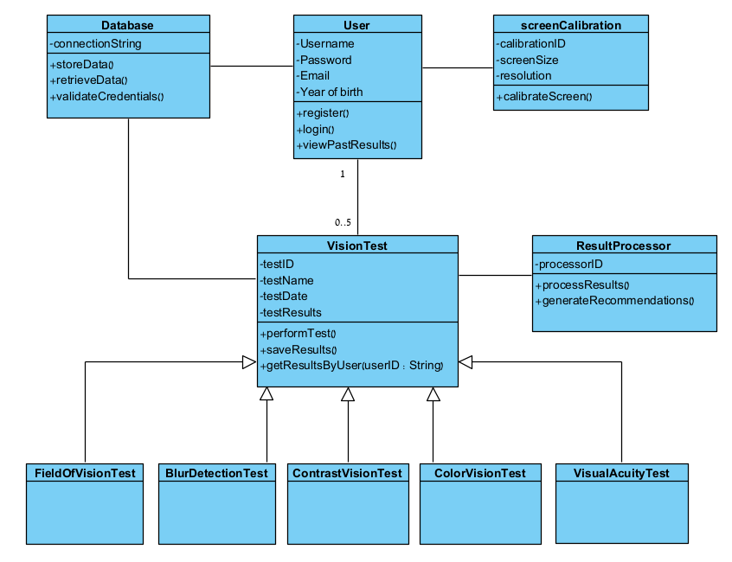
Class Diagram
Notes:
This diagram represents the main components of our system and how they interact with each other.

Slide 16
Testing Plan
Input Hardware: Test that the app accesses monitor, keyboard, and mouse correctly.
Desktop App: Ensure all features work, including login, screen calibration, test execution, and result display.
Database Interaction: Test data storage, retrieval, and validation for user accounts and test results.
Vision Test Accuracy: Validate that all tests (visual acuity, color vision, etc.) are accurate when compared to industry benchmarks.
Notes:
Our testing plan is designed to cover all aspects of the system, from hardware compatibility to data integrity and test accuracy. I will now walk you through the key areas we are focusing on during testing.
Input Hardware: We ensure the app functions correctly across various devices by testing compatibility with different monitors, keyboards, and mice.
Desktop App: We will make sure that all app features work, from login to result display, for seamless operation.
Database Interaction: Our tests confirm that data storage, retrieval, and validation are secure and efficient.
Vision Test Accuracy: We validate the accuracy of our vision tests against clinical standards to ensure reliable health insights.

Slide 17
Evaluation
System Functionality:
Tested for login, calibration, vision tests, and result storage.
Ensured results are saved and retrievable.
User Experience:
Tested for easy navigation and test flow.
Users can follow instructions and perform tests smoothly.
Accuracy:
Verified test results using benchmark data from optometry practices.
Accurate detection of vision issues like color blindness and myopia.
Notes:
System Functionality: We've thoroughly tested crucial features including login, calibration, and vision tests, ensuring all results are stored accurately and retrievable.
User Experience: Our evaluation focused on the ease of navigation and smooth test flow, allowing users to complete tests effortlessly.
Accuracy: We've verified the precision of our tests against industry benchmarks to ensure reliable detection of conditions like color blindness and myopia.

Slide 18
Challenges
Screen Calibration: Ensuring accurate calibration across various monitor sizes.
Lighting variability:
Ensuring that the vision tests remain accurate under different lighting condition.
Secure Data Storage: Implementing secure methods for storing and protecting sensitive user data.
Input Handling: Ensuring compatibility with different hardware inputs (monitors, keyboards, etc.).
Notes:
Screen Calibration:
"We ensure that our tests are accurate on any device by carefully calibrating the screen across different monitor sizes."
Lighting Variability:
“We ensure consistent test accuracy by adapting our vision tests to perform reliably across varying lighting conditions.”
Secure Data Storage:
"We prioritize user privacy by implementing robust security measures to protect sensitive data."
Input Handling:
"Our software is designed to be fully compatible with various hardware inputs like monitors and keyboards, ensuring a smooth user experience."

Slide 19
Conclusion
OptiVision provides a comprehensive tool for early detection of vision impairments.
The system makes vision health more accessible, allowing users to track their vision over time.
Early detection can help prevent severe vision problems, improving quality of life.
OptiVision offers a practical, home-based solution for regular vision screening.

Slide 20
Questions
Thanks for your attention.
Questions?

